Slide 1

CSE406 : Software Engineering
Lecture Room Reservation System
MIA
Seonwoong Kim / Dohwan Ahn / Seungho Hong /
Jaewon Lee / Minho Kim / Jongwon Sim
Presenter : Seungho Hong

Slide 2
Contents
1 . Project Overview
2 . Agile - XP?
3 . Agile - Scrum?
4 . XP? Scrum?

Slide 3
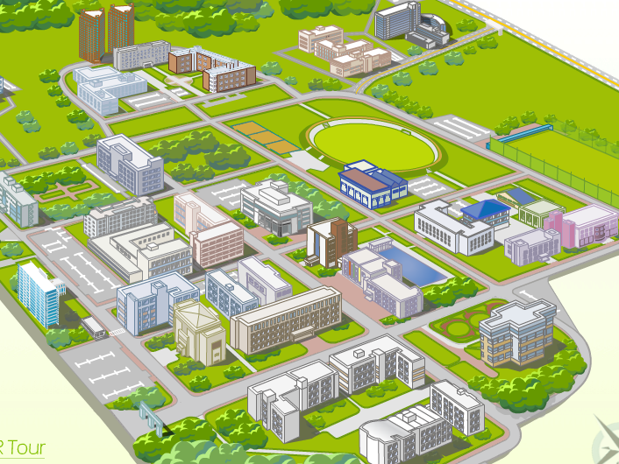
1 . Project Overview
Lecture Room Reservation System
HTML, CSS, PHP, JavaScript, MySQL
DB
UI
Web

Slide 4
2 . Agile - XP?
Agile
Focus on software
Reflect requirements
Fast feedback

Slide 5
2 . Agile - XP?
XP
Weekly Cycle
Pair Programming, Refactoring
Unit Test
Bad
Release
Develop
Test
Inspect
2nd cycle
1st cycle

Slide 6

3 . Agile - Scrum?
Scrum
Sprint & Backlog
Daily short meeting
Prototype
Sprint
Product
Product Backlog
Sprint Backlog
Iteration

Slide 7
4 . XP ? Scrum ?
Iterative Development
Feedback
Short cycle
…

Slide 8
4 . XP ? Scrum ?
Lecture Room Reservation System
Shorter cycle
Impossible Daily meeting
Pair Programming
Not prototype, but Release
Fast Adaption
XP

Slide 9
Q & A

